Slide 1

Lecture 01: Course Introduction CS217: Object Oriented Programming
Maryam Omar
Lecturer (CS)
maryam.omar@nu.edu.pk

Slide 2
About Instructor
Maryam Omar
Contact details:
maryam.omar@nu.edu.pk
0915825594 | Ext 147
http://pwr.nu.edu.pk/cs-faculty
Education:
- MS (Computer Science)
National University of Computer & Emerging Sciences (NUCES), Peshawar. (2019)
- BE (Bachelors in Information and Communication System Engineering)
National University of Science & Technology (NUST), Islamabad. (2013).

Slide 3
Book
Object Oriented Programming in C++ by Robert Lafore

Slide 4
The Big Picture
Need of OOP
Characteristics of OOP
C++ vs C
Groundwork
UML

Slide 5
Need of OOP
Project→ Immediate Coding→Large-Project→Complexity
(Procedural/structured Programming)
Complexity
Prone to errors
Expensive(time, cost)
Unrestricted access to data

Slide 6
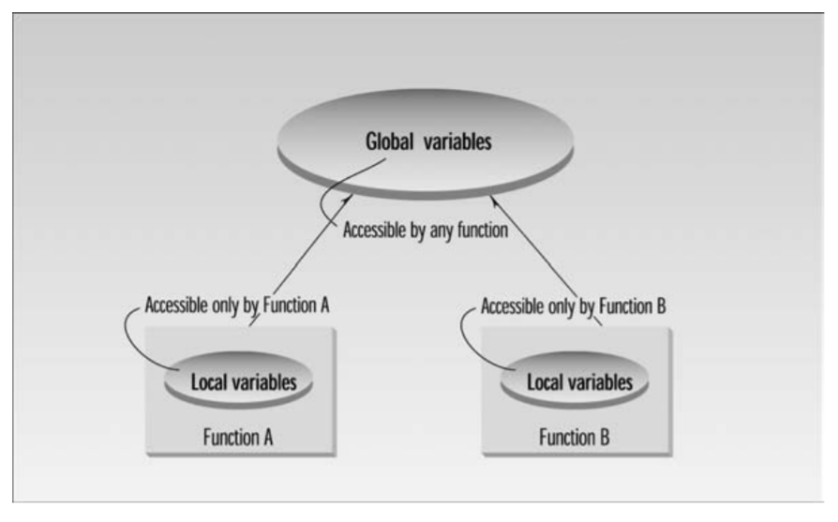
Global vs Local Variable

Slide 7
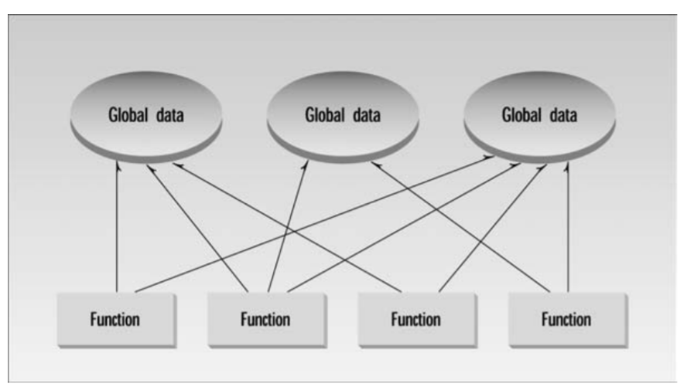
Procedural Paradigm (Organizing Paradigm)

Slide 8
Need of OOP
To cope with problem of complexity
Object Oriented Programming
Unified Modeling Language
Improved Software Development Process
In this course:
Conceptualize Software development

Slide 9
1. Unified Modeling Language
Graphical language

Slide 10
2. Object Oriented Programming
Preferred approach for software development/ projects.
Instead of series of steps, we will have a group of objects where each object:
Will have some properties
Can perform some action
Results:
Clear
Reliable
Easily maintained
Real-world model

Slide 11
Characteristics of OOP

Slide 12
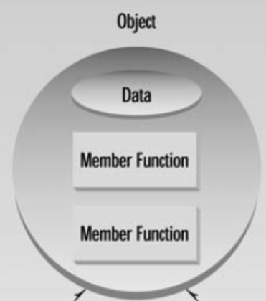
Objects
Real world objects have both attributes (data) and behavior(function)
Idea:
Combine data and functions
that can operate on a data into a
unit. Such unit is called as object.

Slide 13
Member function:
Data is hidden(safe from alterations)
Only way to access data

Slide 14
Classes
Objects are member of classes.
Class serves as blue print/plan.
It specifies what data and functions will be included in objects of that class.
Define class does not create object.
E.g
Prince, sting, madona are objects of rockMusicians class
Bmw,audi,corolla are objects of car class

Slide 15
Reusability
Written, Created and debugged
It can be distributed.

Slide 16
Languages & Development Platforms
Language: C++
[Java: lack some features(pointers, multiple inheritance, templates)]
Development Platform: Dev C++

Slide 17
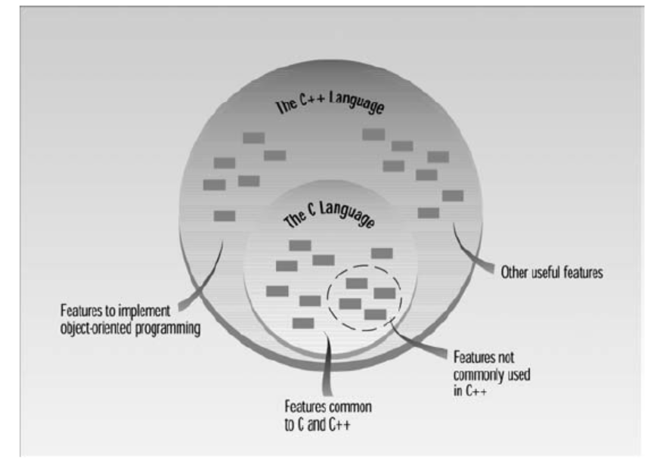
C++ and C

Slide 18
Course Outline
C++ programming Basics
Loops & Decisions
Functions
Arrays & Strings
Structures
Pointers
Objects & Classes
Encapsulation
Abstraction
Header File Concept
Inheritance & Composition
Pointer as a Class Member
Operator Overloading
Polymorphism
Virtual Functions
Templates
The Standard Template Library

